Slide 1


IoT Smart Fridge
Team： YesYepYeah! (对对对队)

Slide 2
CONTENTS
PART 01
Market Survey
PART 02
Specific Techniques
PART 03
Major Function

Slide 3
PART 01
Market Survey

Slide 4
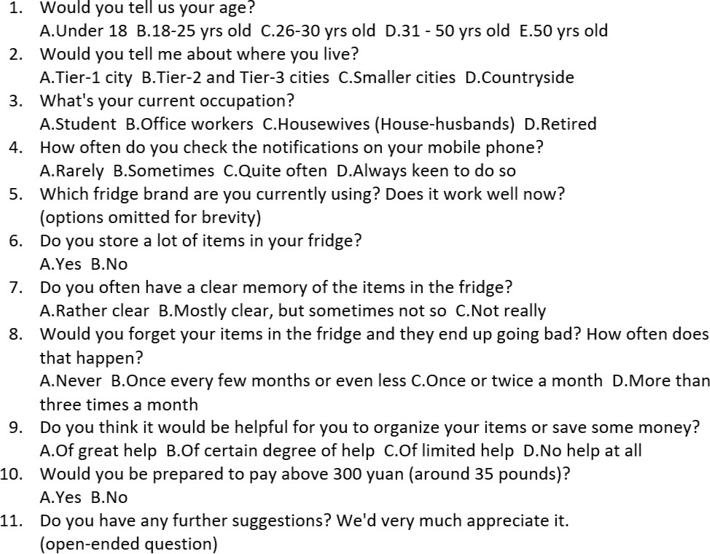
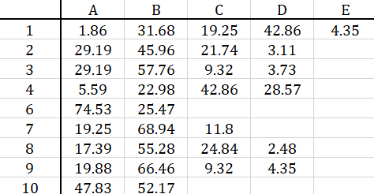
Market Survey
The user can demonstrate on a projector or computer, or print the presentation and make it into a film to be used in a wider field
Concept Development and testing
Marketing Strategy Development
Business Analysis
Product Development
Market Testing

Slide 5
PART 01
Specific Techniques

Slide 6
Specific Techniques
The user can demonstrate on a projector or computer, or print the presentation and make it into a film to be used in a wider field
Computer Vision(CV):
Put in: object detection(YOLOv3)+Taobao image search API
Take out: object detection(YOLOv3)+Image Retrieval(ReID)
Users:
Mobile Phone APP
Mysql Database
Microsoft Azure:
Docker(YOLOv3, ReID API)+ Database Service

Slide 7
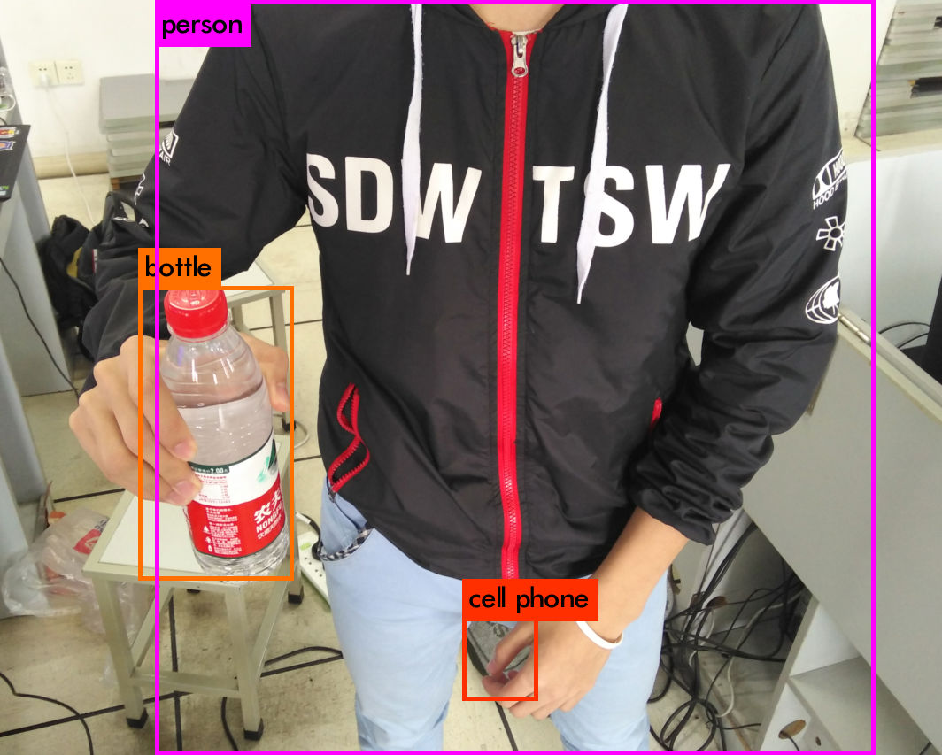
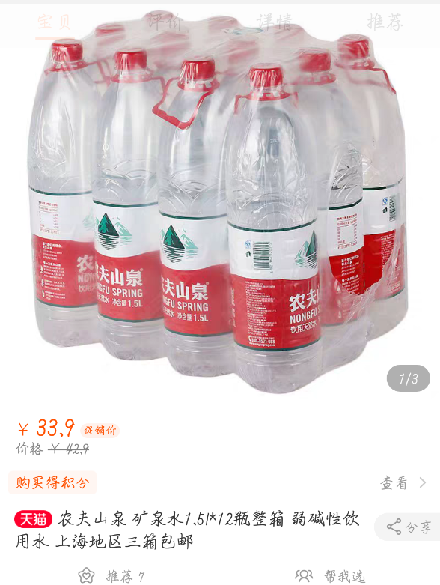
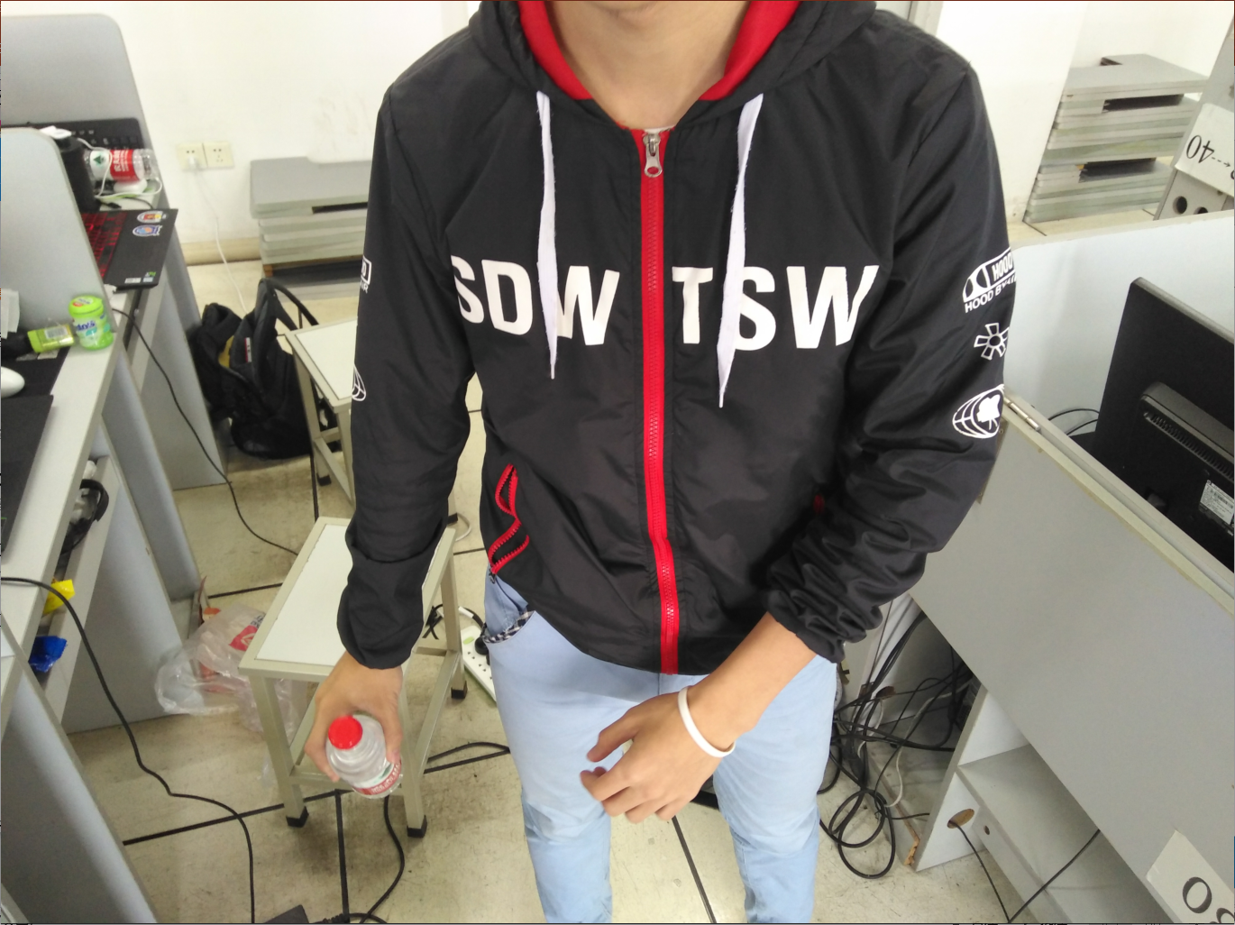
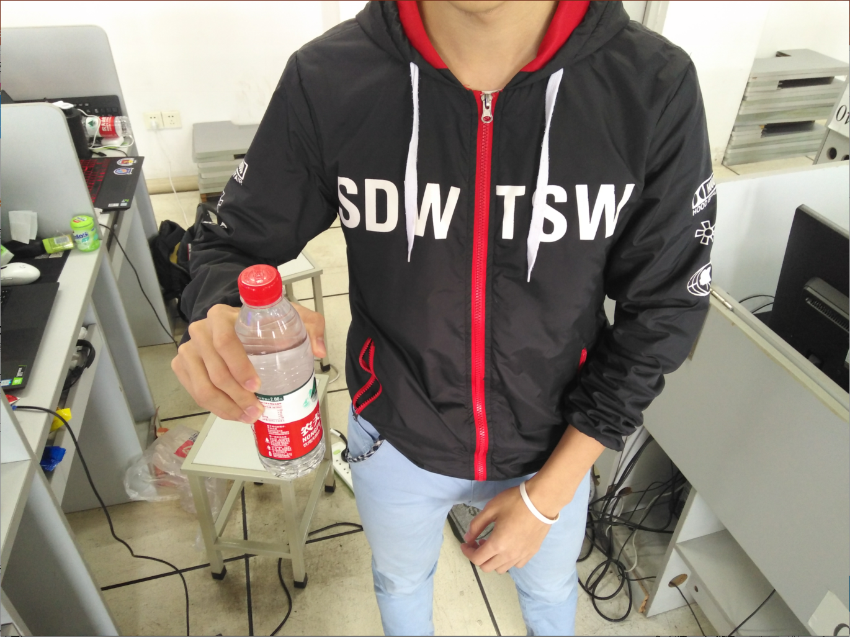
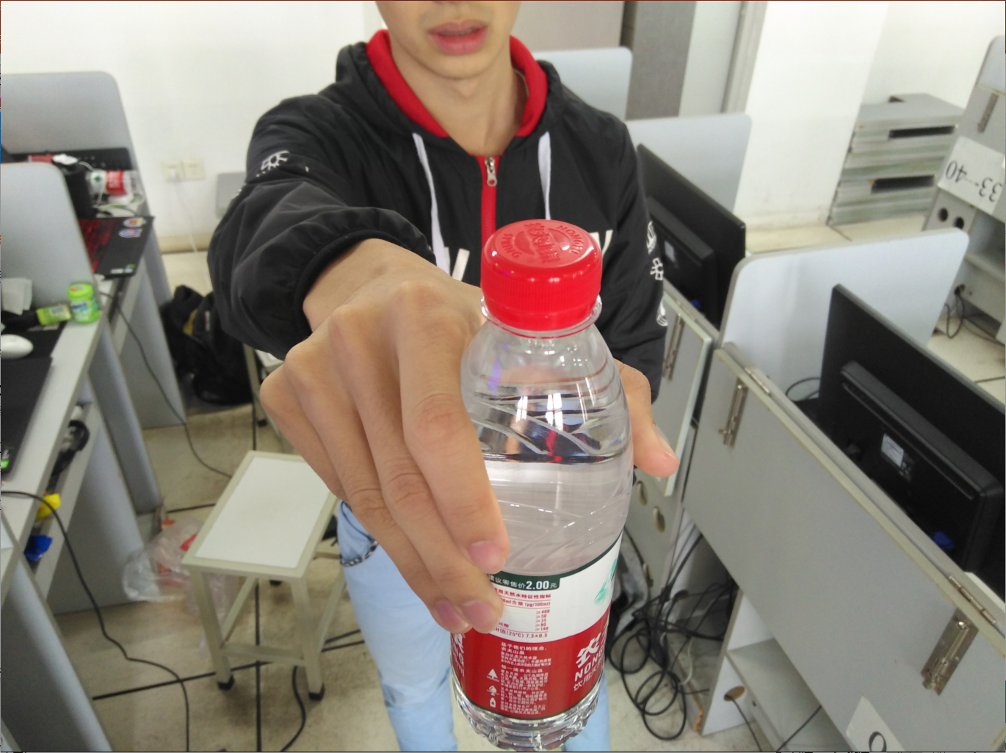
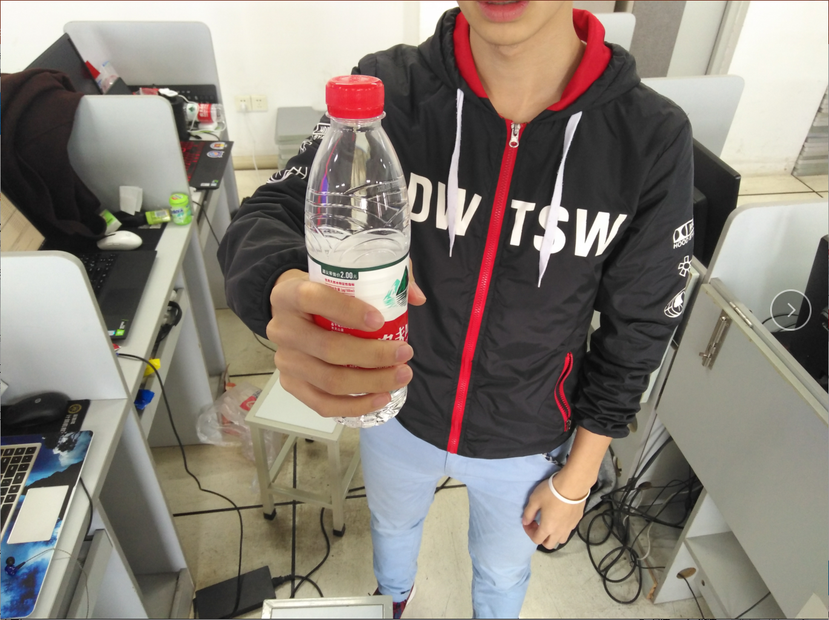
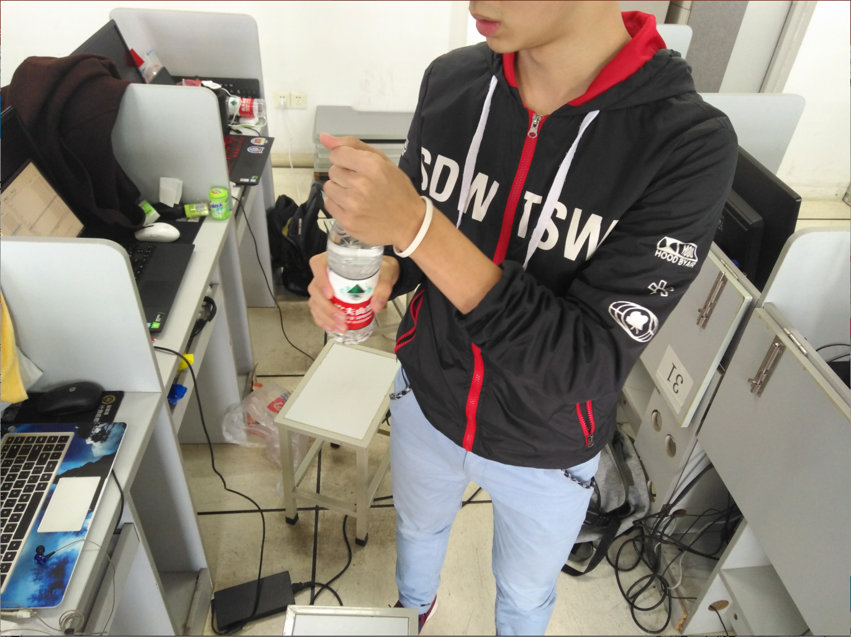
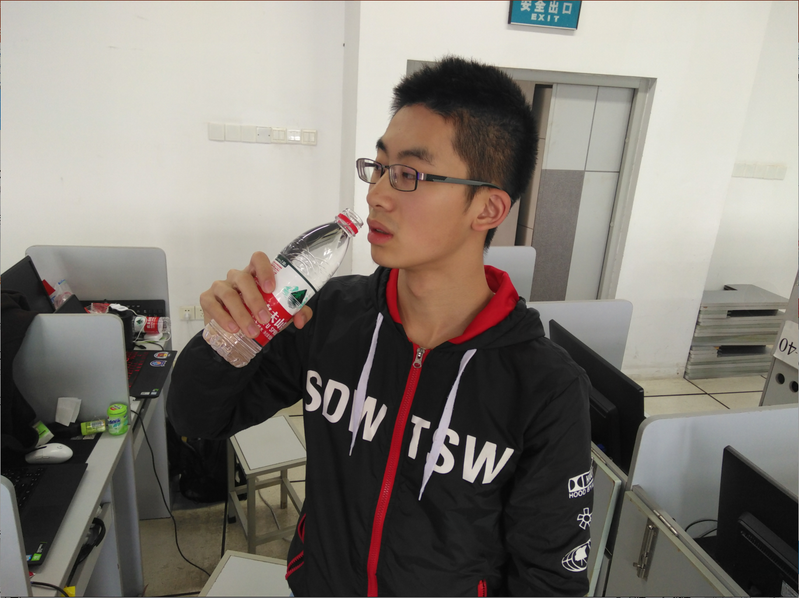
Specific Techniques
The user can demonstrate on a projector or computer, or print the presentation and make it into a film to be used in a wider field
Computer Vision(CV):
Put in: object detection(YOLOv3)+
Taobao image search API
Take out: object detection(YOLOv3)+
Image Retrieval(ReID)

Slide 8
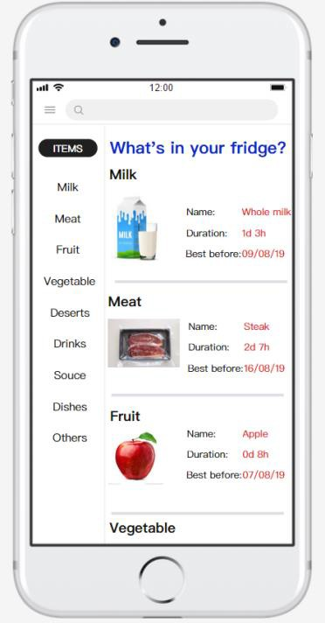
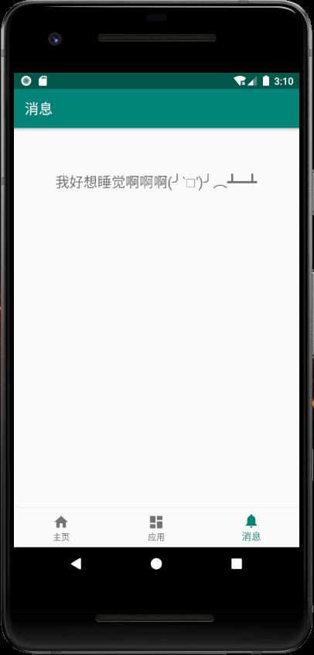
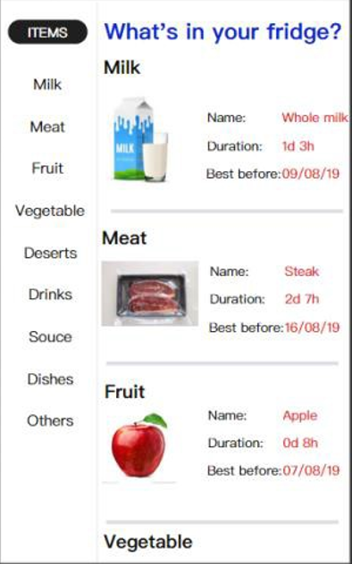
Specific Techniques
The user can demonstrate on a projector or computer, or print the presentation and make it into a film to be used in a wider field
Users:
Mobile Phone APP
Mysql Database

Slide 9
PART 02
Major Function
The user can demonstrate on a projector or computer, or print the presentation and make it into a film to be used in a wider field

Slide 10
Major Function
Fresh Remind: Users can set their own eating time when they want to remind themselves.
Replenishment: We can use the API of the SHOPPING APP, to complete the replenishment operation.
Voice Service: We maintain a voice assistant to interact with the user and do some confirmation and inquiry.

Slide 11
Major Function
Putting in: While putting in, the fridge will use YOLO to detect what we are interested in and crop it. Then we use APIs to know what we already have, and have a multivariate information of the product.
Taking out: While taking out, we also use YOLO to crop what we are interested in. Then we use ReID technique to match the OUT item in the database of IN items.

Slide 12
Thanks!
The user can demonstrate on a projector or computer, or print the presentation and make it into a film to be used in a wider field

